Slide 1
Operating the Microsoft Cloud Platform System
Steve Linehan
Principal Program Manager
Enterprise Cloud Group

Slide 2
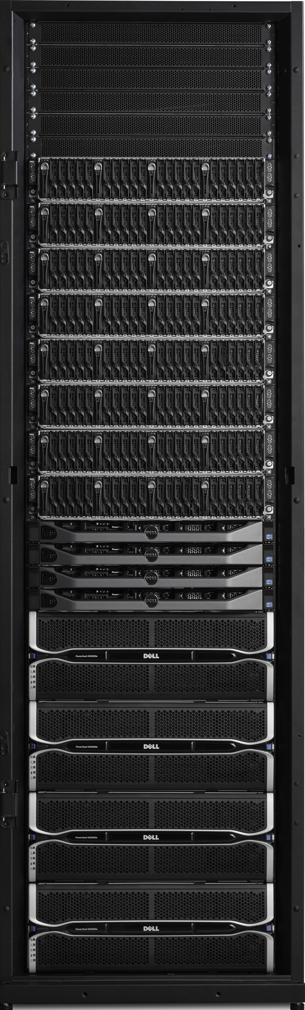
CPS - Integrated solution for HW and SW
One Rack
512 Cores
8TB RAM
282 TB usable storage
1360 Gb/s internal connectivity
560 Gb/s inter-rack connectivity
60 Gb/s external
2322 Lbs
42U
16.6 KW Maximum
Networking
5 x Force 10 – S4810P
1 x Force 10 – S55
Compute Scale Unit (32 x Hyper-V hosts)
Dell PowerEdge C6220ii – 4 Nodes per 2U
Dual socket Intel IvyBridge (E5-2650v2 @ 2.6GHz)
256 GB memory
2 x 10 GbE Mellanox NIC’s (LBFO Team, NVGRE offload)
2 x 10 GbE Chelsio (iWARP/RDMA)
1 local SSD 200 GB(boot/paging)
Storage Scale Unit (4 x File servers, 4 x JBODS)
Dell PowerEdge R620v2 Servers (4 Server for Scale Out File Server
Dual socket Intel IvyBridge (E5-2650v2 @ 2.6GHz)
2 x LSI 9207-8E SAS Controllers (shared storage)
2 x 10 GbE Chelsio T520 (iWARP/RDMA)
PowerVault MD3060e JBODs (48 HDD, 12 SSD)
4 TB HDDs and 800 GB SSDs
1 – 4 racks

Slide 3
Cloud Platform System
Rack 1
Rack 2
Rack 3
Rack 4
Networking
Agg Switches
Mgmt Switches
Agg Switches
Mgmt Switches
Agg Switches
Mgmt Switches
Agg Switches
Mgmt Switches
Access switches
Access switches
Access switches
Access switches
Compute
32 servers per rack
128 maximum
Mgmt cluster
Management host group
Edge cluster
Edge cluster
Edge cluster
Edge cluster
Edge host group
Compute cluster
Compute cluster
Compute cluster
Compute cluster
Compute host group
Storage
282 TB per rack
1.1 PB maximum
Storage cluster
Storage cluster
Storage cluster
Storage cluster
Storage host group

Slide 4
Cloud Platform System
Rack 1
Rack 2
Rack 3
Rack 4
Networking
Agg Switches
Mgmt Switches
Agg Switches
Mgmt Switches
Agg Switches
Mgmt Switches
Agg Switches
Mgmt Switches
Access switches
Access switches
Access switches
Access switches
Compute
32 servers per rack
128 maximum
Mgmt cluster
Management host group
Edge cluster
Edge cluster
Edge cluster
Edge cluster
Edge host group
Compute cluster
Compute cluster
Compute cluster
Compute cluster
Compute host group
Storage
282 TB per rack
1.1 PB maximum
Storage cluster
Storage cluster
Storage cluster
Storage cluster
Storage host group

Slide 5
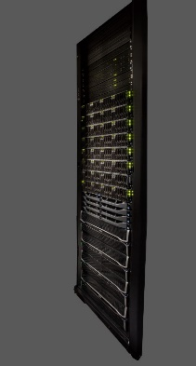
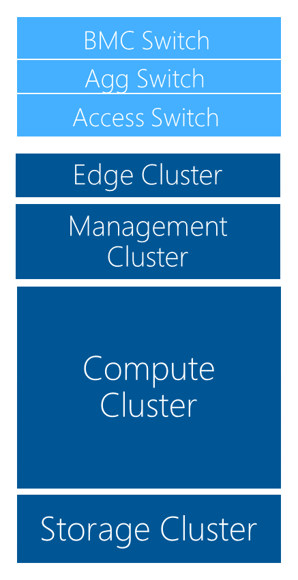
Management Cluster
Mgmt AD
AD/DNS/DHCP (3)
WDS (1)
WSUS (1)
WAP Tenant API (2)
WAP Admin Portal/API, Service Reporting (3)
ADFS (2)
IaaS RP (SPF) (2)
SMA (3)
Deployed for HA
VMM (2)
OM (3)
Console (4)
VMM Library (1)
Service Templates
SQL Cluster for dB’s (4 VM’s)
(VMM, OM, SPF, WSUS, SMA, WAP, DW, Analysis Services)
DPM (1) (for backing up Management cluster)
32 VM’s on a 6 x node Hyper-V failover cluster

Slide 6
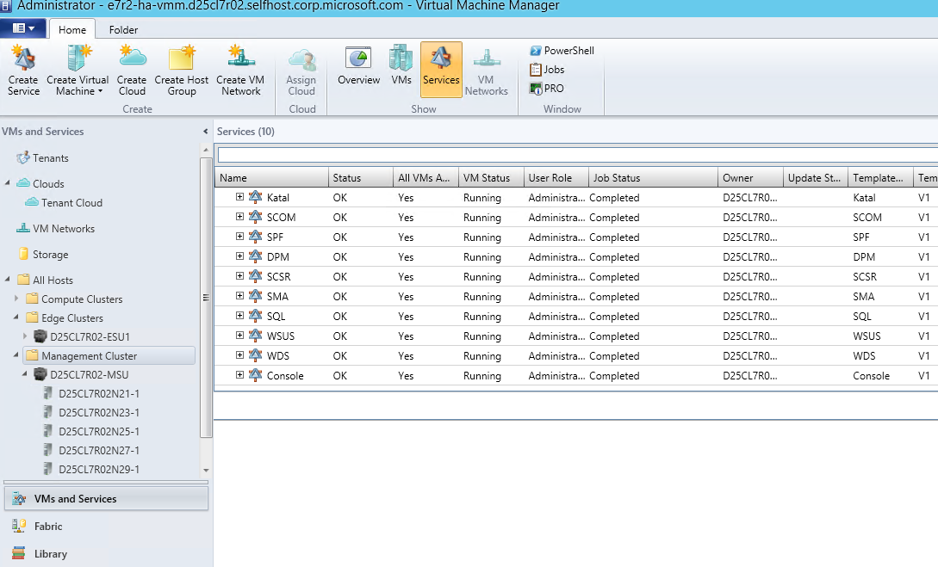
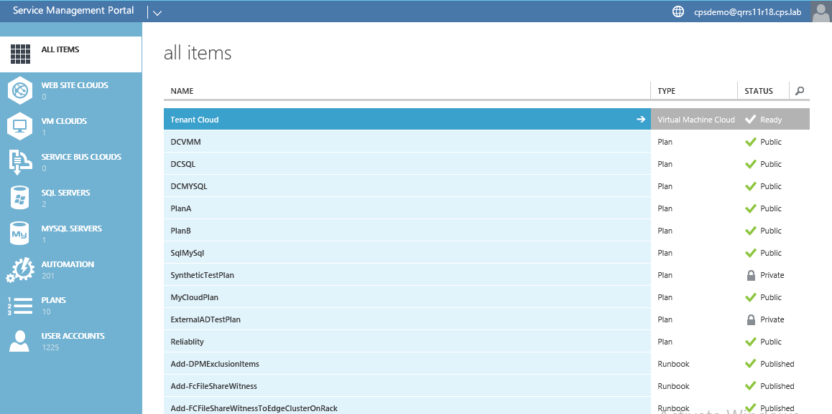
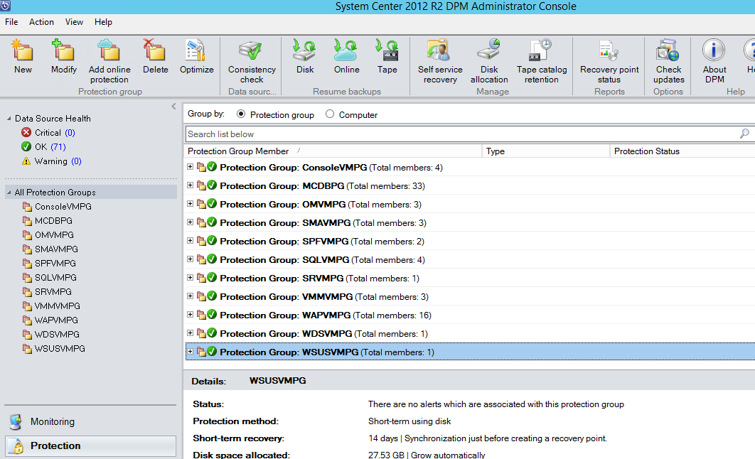
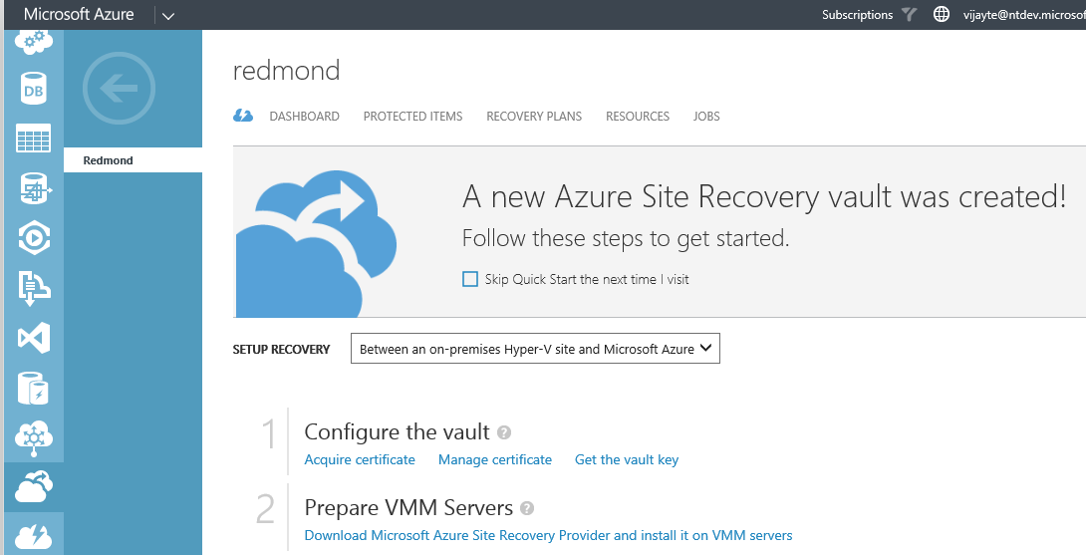
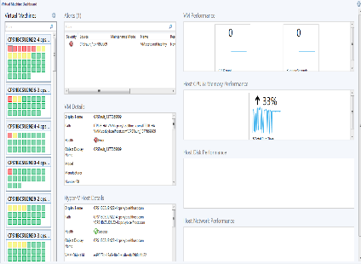
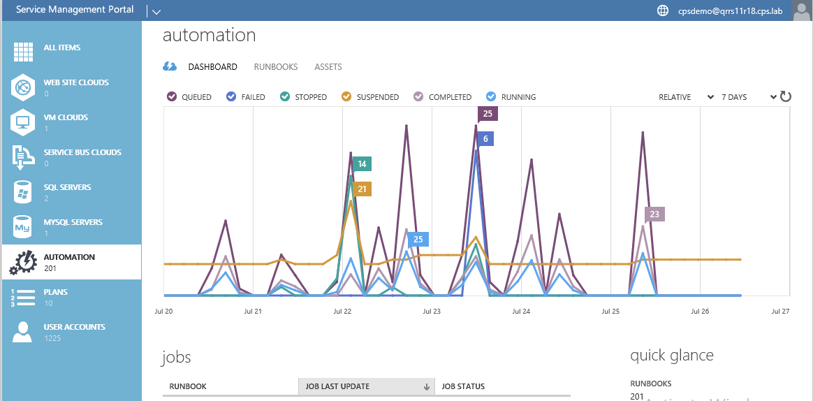
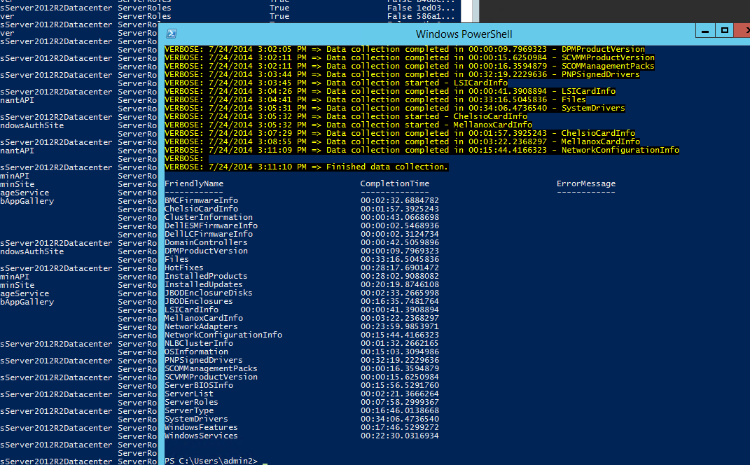
CPS – Management Services
Configure/deploy
Service Administration
Backup (Tenant/MC)
Disaster Recovery
Monitoring
Automation
Patching & Upgrade

Slide 7
Monitoring

Slide 8
CPS 1.0 Monitoring Goals
Deploy and configure all required monitoring infrastructure and agents via automated methods
Provide current, actionable health state of Hosts, Infrastructure VMs (Management Cluster, Edge Cluster, WAP Tenant Services), and the CPS software components.
When problems occur with the CPS Stamp as a Fabric Admin I receive actionable alerts
During CPS Stamp Maintenance I can pause monitoring using documented maintenance mode steps to avoid false alerting.

Slide 9


OpsMgr in Cloud Platform System (CPS)
Integrated testing of management packs during CPS development. What did we find out?
Management Packs can be noisy!
Understanding fabric health is difficult
Making sense of CPS monitoring
Tuned management packs to reduce health and alert noise (overrides + MP fixes)
Create centralized dashboard visualizations for health and alerts
Results?
Eliminated need for customer tuning of OpsMgr MPs
Reduced time spent investigating noisy alerts
Decreased time to effective monitoring

Slide 10
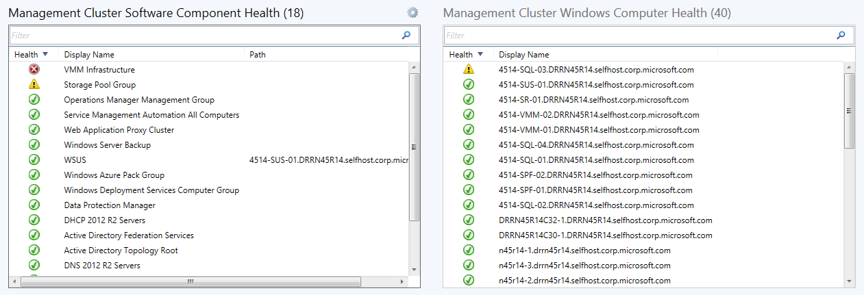
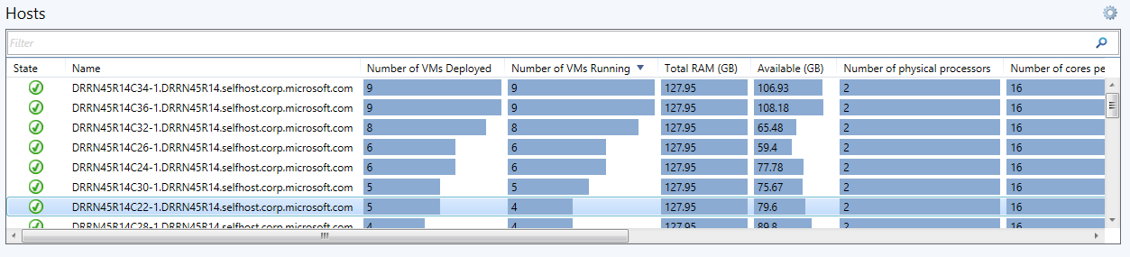
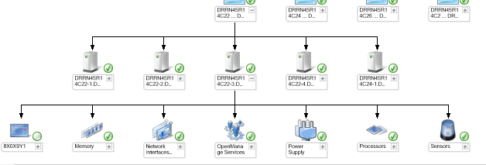
What’s monitored in CPS?
Management Cluster
All Hosts and VMs
All Management SW Components (Windows, SC, WAP)
Computer and Storage Clusters
All Hosts and VMs supporting WAP Tenant Portal
WAP Tenant Portal
Windows Storage Spaces (SOFS)
Edge Cluster
All Hosts and VMs
Multi-tenant RAS
Hardware
Dell Servers, Switches, JBODs (via Storage Spaces MP)
HBA Adapters
F5 Load Balancer

Slide 11
Patch & Update

Slide 12
Some of today’s update problems…
Error prone, tedious task that no one likes
Disruption of tenant workload or management functions = not good for business
Multiple, complex tools & processes going from staging to QA to pre-prod to prod…
Wasted time looking for patches from multiple sources with a multitude of release cadences

Slide 13
So, what did we build? Enter CPS P&U
P&U provides automated CPS servicing using a single, simple tool
Fingerprints a CPS stamp including hardware, firmware & software
Automatic update of all pre-validated Windows Server, System Center, SQL & Windows Azure Pack updates
Validates all workloads after servicing to ensure availability
Designed to support “offline/submarine” scenario
Enables production-ready update release cadence
Component sequencing & dependency aware to avoid disruptions in tenant workloads or management functions

Slide 14
Importance of dependencies & sequence

Slide 15
What to leave in…what to leave out?
Not everything is for CPS so we implemented a Points/Scoring system for:
Security updates
Critical updates
General Distribution Releases (GDR)
Limited Distribution Releases (LDR)
Update Rollups
Cumulative Updates
Cadence: Build minor and major CPS P&U Update Packages for customers
Minor updates as-needed, major updates quarterly

Slide 16
Additional benefits
Enable faster update cadence
Quicker feature turnaround
Increased reliability
P&U as a controlled process
Pre-validated patch bundles
Halted process in case of update failure
Simpler validation matrix
Uniform installation base
Limited set of possible configurations
Improve Customer Support Service
Customer update level awareness
Customer setup easily reproducible
Uniform logging and validation approach

Slide 17
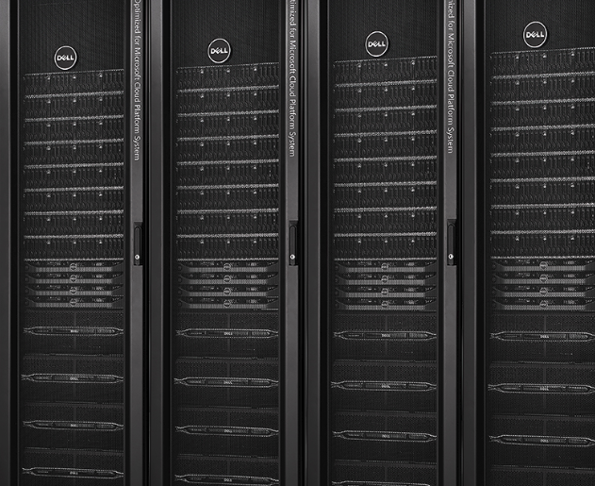
Lastly, here is the P&U “rack flow”
CPS Update 0.1
Inventory
Update Windows Server
Validate Windows Server
Update System Center
Validate System Center
Update Windows Azure Pack
Validate Windows Azure Pack
CPS Update
0.2
Compute Node
Highly Available Virtual Machine Workloads
Compute Node
Orchestration
Compute Node
Running Workloads Keep Running
Live Migration
Maintenance Mode

Slide 19
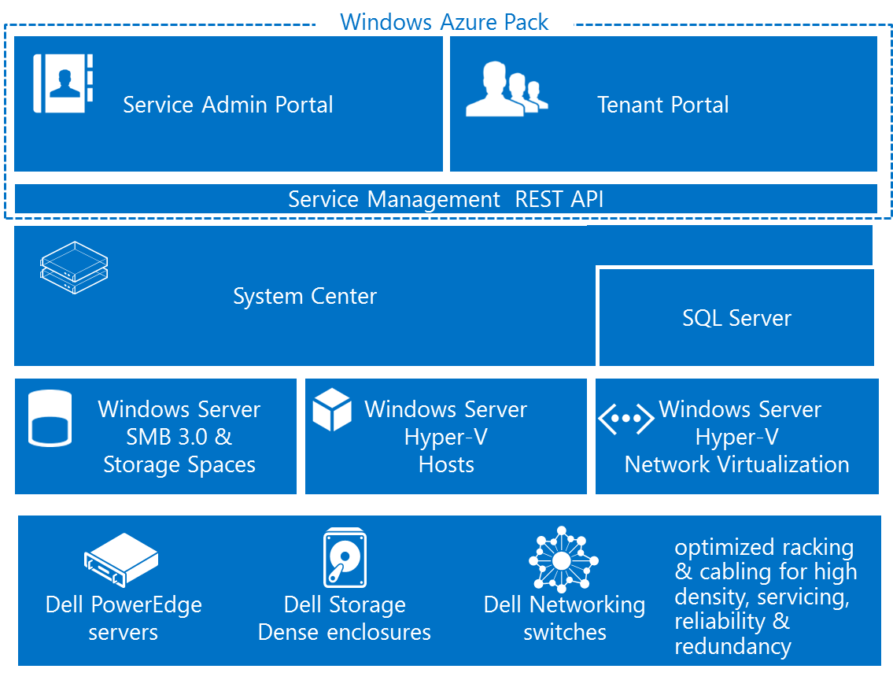
Cloud Platform System - Capabilities
Self-service portal (Windows Azure Pack)_ with integrated usage reporting
Pre-deployed stack configured by product team.
Arrives fully deployed and integrated
Optimal fault tolerant design
Integrated Management
Service Administration
Patching
Monitoring
Backup and DR
Automation
One rack: 512 cores, 8 TB RAM, 156 TB Tiered Storage
Optimized deployment and operations for Microsoft and other standard workloads

Slide 20
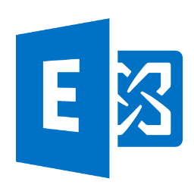
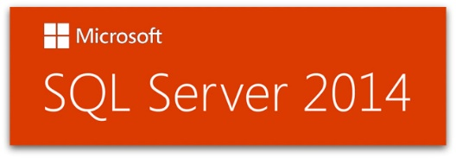
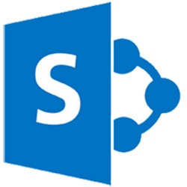
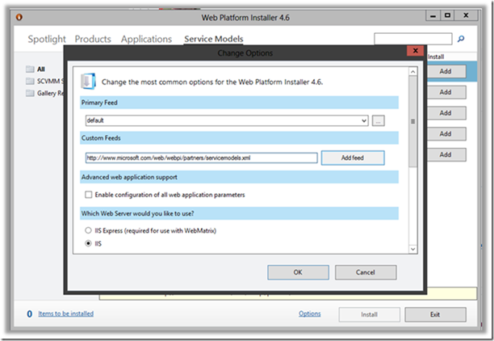

Self –Service Deployment of Workloads
Exchange
SQL Server
SharePoint
Skype for business
Microsoft RDS, VDI
Azure Websites
Downloadable today via WebPI feed
http://www.microsoft.com/web/webpi/partners/servicemodels.xml

